Slide 1
Request Pipeline
Server course – lesson 2
© Ayala Gottfried

Slide 2
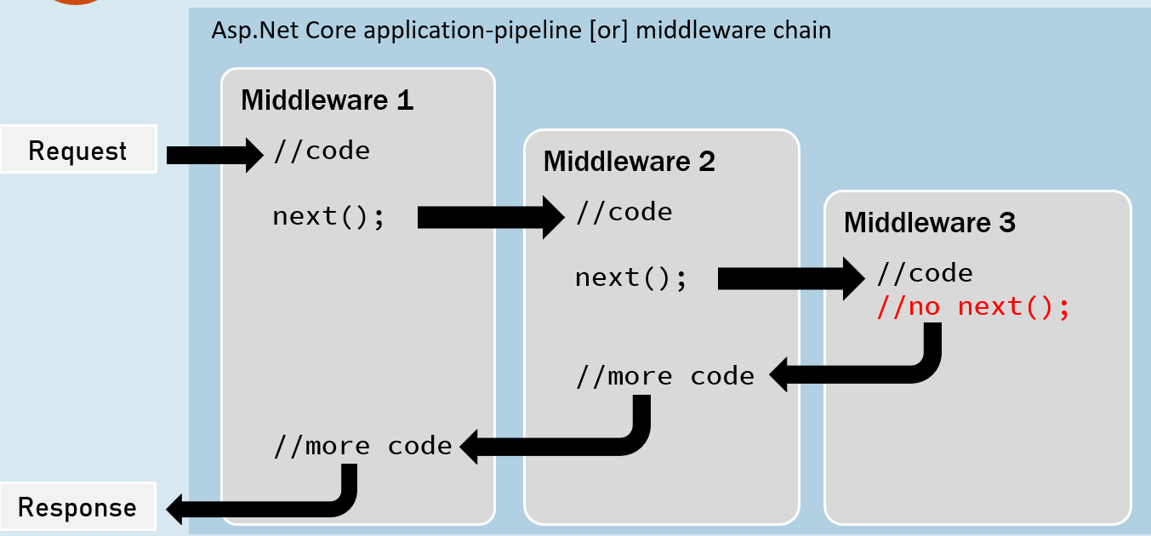
Middleware Chain

Slide 3
app.Use
runs code and continue to the next middleware
app.Run
runs code and terminates the request pipeline

Slide 4
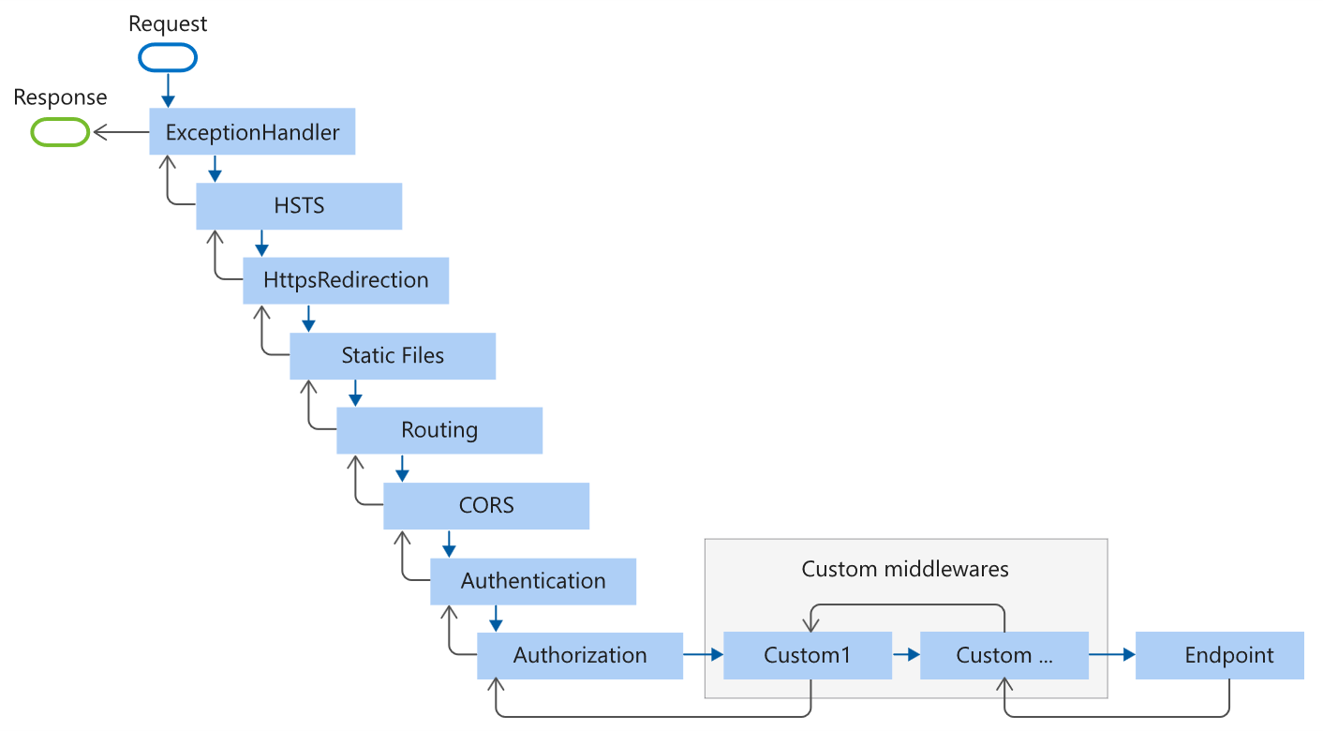
Request Pipeline

Slide 5
Built In Middlewares
Exception Handler
Swagger
Static Files
Map Controllers
CORS
Authentication
Authorization
Custom Middleware
Action
Output Caching

Slide 6
Exception Handler
Exception Middleware
error
MW
MW
error
error
MW
action
error

Slide 7
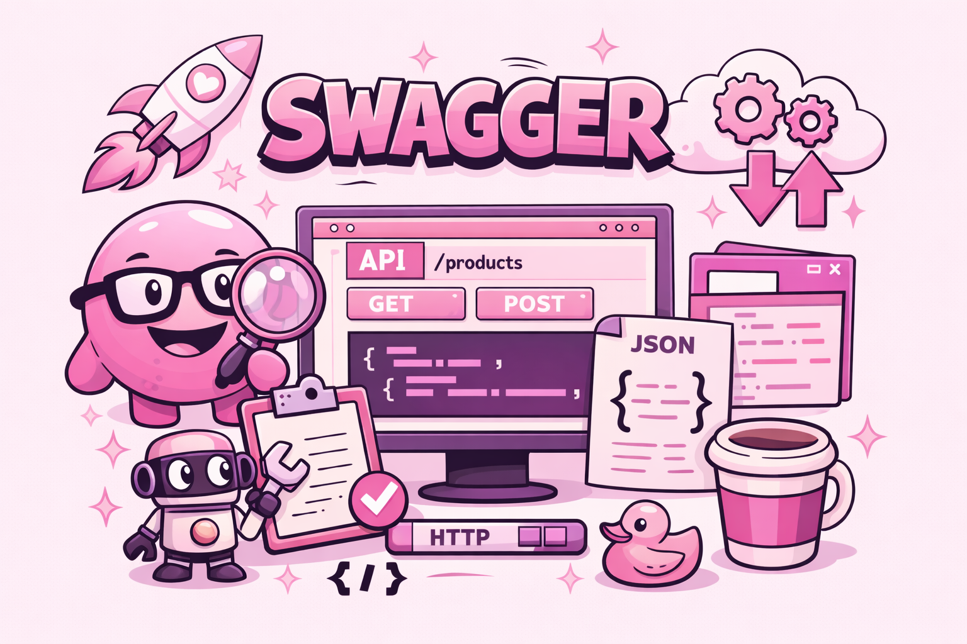
Swagger

Slide 8



Output Caching
First request
request to server
check in cache
save in cache
Subsequent requests

Slide 9
Authentication
Authorization

Slide 10
CORS
Cross-Origin Resource Sharing
Same Origin Policy
Security feature to prevent web pages from making requests to a different domain for security reasons
Cross Origin Requests
Sometimes we must access APIs or resources hosted on different domains

